Slide 1



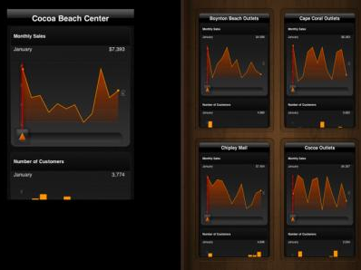





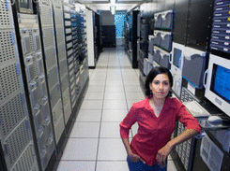
REAL-WORLD EVIDENCE MEETS BIG DATA:
Implications for Patient-Centered Analytics
Andrew Kress
SVP, Healthcare Value Solutions
October 17, 2012

Slide 2
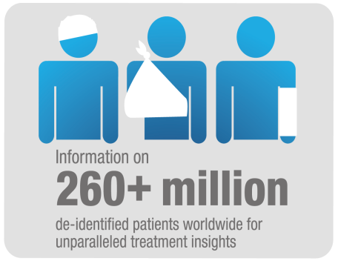
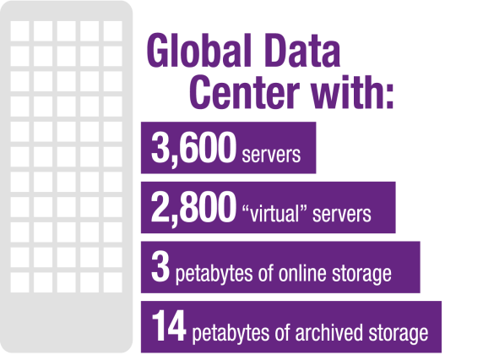
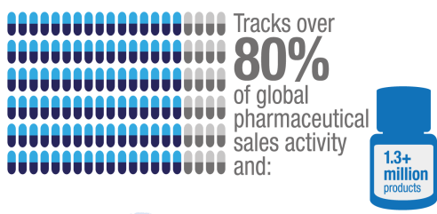
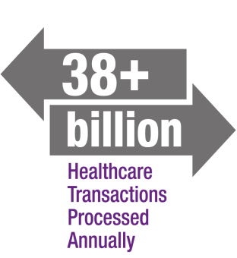

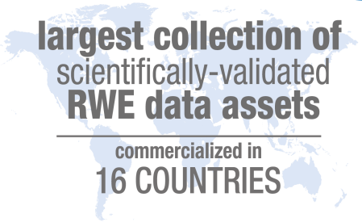

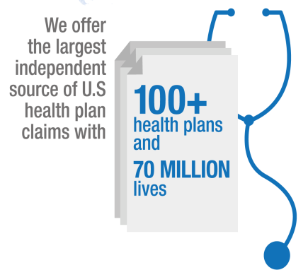

IMS HEALTHCARE ANALYTICS
Global Capabilities Snapshot

Slide 3
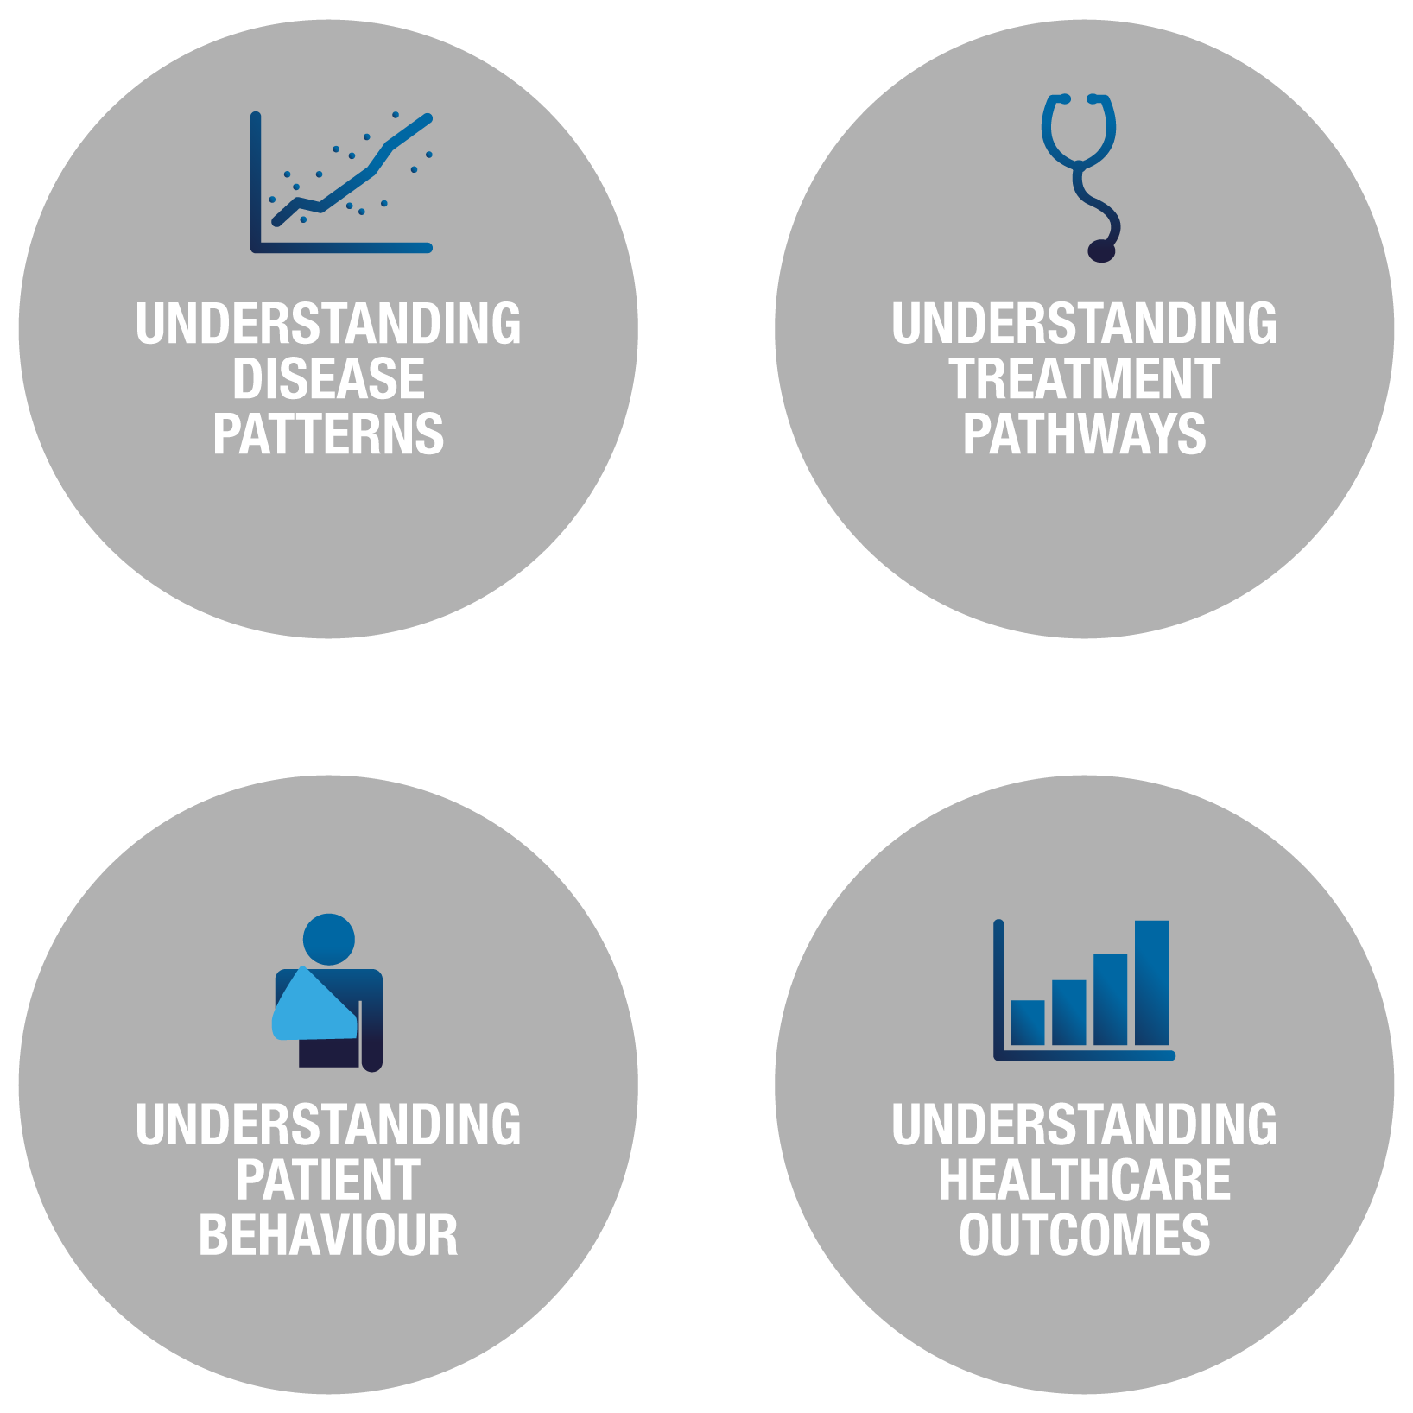

BIG DATA, BIG CHALLENGES
TECHNICAL
Person vs. population ‘Butterfly effect’ New data types Gaps: Methodologies, tools, workforce, quality measures
ACCESS
Healthcare data infrastructure Disruptive change limits No. of available sources
POLICY
Information asymmetry ‘Prove it’ era Privacy Regulatory vs. real world
Patient-centered healthcare
3
IMS Healthcare Value Solutions
Copyright © 2012 IMS Health. All Rights Reserved.

Slide 4
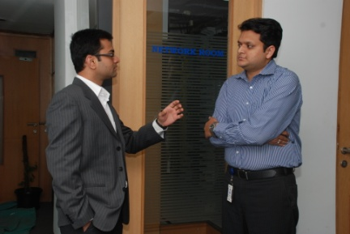



IMS REAL-WORLD EVIDENCE CAPABILITIES
Data Sourcing
Information Management
Analytics & Interpretation
Communication
Data access strategy, acquisition & assessment
Data curation, integration, warehousing & privacy mgmt.
Methods governance, standard analytics, platforms & tools; custom research
Reports, evidentiary documents & publications
Scientifically validated evidence base that captures a patient’s full interaction with the healthcare system
4
IMS Healthcare Value Solutions
Copyright © 2012 IMS Health. All Rights Reserved.

Slide 5


